Slide 1
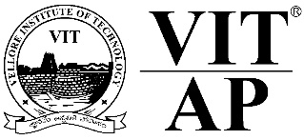
Course code : CSE4001 Course title : Cloud Computing Module : 1 Week : 2 Session : 4
Understanding Cloud Computing

Slide 2
Last Week (Chapter 5)
Introduction to Cloud
Cloud Importance
Cloud Roles and boundaries
Characteristics
Service Models(IaaS, PaaS, SaaS)
Deployment models(Private, public, hybrid, Community)
Integration of IaaS+ PaaS & IaaS+ PaaS+ SaaS

Slide 3

Understanding Cloud Computing
Chapter 3

Slide 4
Topics
Cloud Origins and Influences pp.26-32
Basic Concepts and Terminology pp.33-40

Slide 5
Topic 1. Cloud origins and influences
Cloud : A brief history
Definitions
Business drivers
Capacity Planning
Cost Reductions
Organizational Agility
Technical innovations
Clustering
Grid Computing
Virtualization

Slide 6
A Brief History
The idea of computing in a “cloud” traces back to the origins of utility computing, a concept that computer scientist John McCarthy publicly proposed in 1961:
“If computers of the kind I have advocated become the computers of the future, then computing may someday be organized as a public utility just as the telephone system is a public utility. ... The computer utility could become the basis of a new and important industry.”

Slide 7
A Brief History (cont.)
In 1969, Leonard Kleinrock, a chief scientist of the Advanced Research Projects Agency Network or ARPANET project that seeded the Internet, stated:
“As of now, computer networks are still in their infancy, but as they grow up and become sophisticated, we will probably see the spread of ‘computer utilities’ ...”.

Slide 8
A Brief History (cont.)
The general public has been leveraging forms of Internet-based computer utilities since the mid-1990s through various incarnations of search engines (Yahoo!, Google), e-mail services (Hotmail, Gmail), open publishing platforms (MySpace, Facebook, YouTube), and other types of social media (Twitter, LinkedIn).
In the late 1990s, Salesforce.com pioneered the notion of bringing remotely provisioned services into the enterprise.
In 2002, Amazon.com launched the Amazon Web Services (AWS) platform, a suite of enterprise-oriented services that provide remotely provisioned storage, computing resources, and business functionality.
A slightly different evocation of the term “Network Cloud” or “Cloud” was introduced in the early 1990s throughout the networking industry. The networking industry still references the use of this term, and is considered an early adopter of the concepts that underlie utility computing.

Slide 9
A Brief History (cont.)
In 2006 Amazon launched its Elastic Compute Cloud (EC2) services that enabled organizations to “lease” computing capacity and processing power to run their enterprise applications.
Google Apps also began providing browser-based enterprise applications in the same year, and three years later, the Google App Engine became another historic milestone.

Slide 10
Definitions
A Gartner report listing cloud computing at the top of its strategic technology areas further reaffirmed its prominence as an industry trend by announcing its formal definition as:
“...a style of computing in which scalable and elastic IT-enabled capabilities are delivered as a service to external customers using Internet technologies.”

Slide 11
Definitions (cont.)
Forrester Research provided its own definition of cloud computing as:
“...a standardized IT capability (services, software, or infrastructure) delivered via Internet technologies in a pay-per-use, self-service way.”

Slide 12
Definitions (cont.)
The definition that received industry-wide acceptance was composed by the National Institute of Standards and Technology (NIST).
“Cloud computing is a model for enabling ubiquitous, convenient, on demand network access to a shared pool of configurable computing resources (e.g., networks, servers, storage, applications, and services) that can be rapidly provisioned and released with minimal management effort or service provider interaction. This cloud model is composed of five essential characteristics, three service models, and four deployment models.”

Slide 13
Definitions (cont.)
This book provides a more concise definition:
“Cloud computing is a specialized form of distributed computing that introduces utilization models for remotely provisioning scalable and measured resources.”

Slide 14
Business Drivers
Capacity planning
Capacity planning is the process of determining and fulfilling future demands of an organization’s IT resources, products, and services.
A discrepancy between the capacity of an IT resource and its demand can result in a system becoming either inefficient (over-provisioning) or unable to fulfill user needs (under-provisioning).
Capacity planning is focused on minimizing this discrepancy to achieve predictable efficiency and performance.
Planning for capacity can be challenging because it requires estimating usage load fluctuations.

Slide 15
Business Drivers (cont.)
Cost Reduction
A direct alignment between IT costs and business performance can be difficult to maintain. The growth of IT environments often corresponds to the assessment of their maximum usage requirements.
This can make the support of new and expanded business automations an ever increasing investment.
Two costs need to be accounted for:
the cost of acquiring new infrastructure,
the cost of its ongoing ownership.

Slide 16
Business Drivers (cont.)
Organizational Agility
Organizational agility is the measure of an organization’s responsiveness to change.
The IT department often needs to respond to business change by scaling its IT resources beyond the scope of what was previously predicted or planned for.

Slide 17
Technology Innovations
Clustering
A cluster is a group of independent IT resources that are interconnected and work as a single system.
A general prerequisite of hardware clustering is that its component systems have reasonably identical hardware and operating systems to provide similar performance levels when one failed component is to be replaced by another.
Component devices that form a cluster are kept in synchronization through dedicated, high-speed communication links.
The basic concept of built-in redundancy and failover is core to cloud platforms.

Slide 18
Technology Innovations (cont.)
Grid Computing
A computing grid (or “computational grid”) provides a platform in which computing resources are organized into one or more logical pools. These pools are collectively coordinated to provide a high performance distributed grid, sometimes referred to as a “super virtual computer.”
Grid computing differs from clustering in that grid systems are much more loosely coupled and distributed. As a result, grid computing systems can involve computing resources that are heterogeneous and geographically dispersed, which is generally not possible with cluster computing-based systems.
The technological advancements achieved by grid computing projects have influenced various aspects of cloud computing platforms and mechanisms, specifically in relation to common feature-sets such as networked access, resource pooling, and scalability and resiliency.

Slide 19
Technology Innovations (cont.)
Virtualization
Virtualization represents a technology platform used for the creation of virtual instances of IT resources.
A layer of virtualization software allows physical IT resources to provide multiple virtual images of themselves so that their underlying processing capabilities can be shared by multiple users.
Established virtualization technologies can be traced to several cloud characteristics and cloud computing mechanisms, having inspired many of their core features. As cloud computing evolved, a generation of modern virtualization technologies emerged to overcome the performance, reliability, and scalability limitations of traditional virtualization platforms.

Slide 20
Topic 2 : Basic Concepts and Terminology
Cloud
IT Resource
On-Premise
Cloud Consumers and Cloud Providers
Scaling
Cloud Service
Cloud Service Consumer

Slide 21
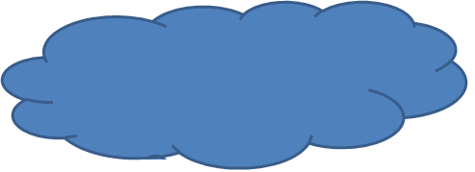
Basic Concepts and Terminology
Cloud:
A cloud refers to a distinct IT environment that is designed for the purpose of remotely provisioning scalable and measured IT resources.
Cloud has finite boundary.
A cloud typically privately owned and offers access to IT resources that is metered.
It allows any protocols that allows remote access

Slide 22
2. IT Resources-Physical/Virtual Artifacts
Physical Server
Virtual Server
Software Program
Services
Storage Devices
Network Devices

Slide 23
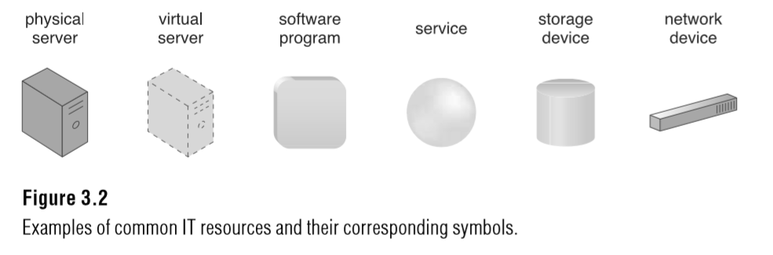
IT Resources
Physical or virtual resources

Slide 24
3. On-premise
The term “on-premise” is another way of stating “on the premises of a
controlled IT environment that is not cloud-based.
Note the following key points:
• An on-premise IT resource can access and interact with a cloud-based IT resource.
• An on-premise IT resource can be moved to a cloud, thereby changing it to a cloud-based IT resource.
• Redundant deployments of an IT resource can exist in both on-premise and cloud based environments.

Slide 25
4.Cloud Consumers and Cloud Providers
The party that provides cloud-based IT resources is the cloud provider.
The party that uses cloud-based IT resources is the cloud consumer.
These terms represent roles usually assumed by organizations in relation to clouds and corresponding cloud provisioning contracts.

Slide 26
Scaling
The ability of the IT resource to handle increased or decreased usage demands.
The following are types of scaling:
• Horizontal Scaling – scaling out and scaling in
• Vertical Scaling – scaling up and scaling down

Slide 27
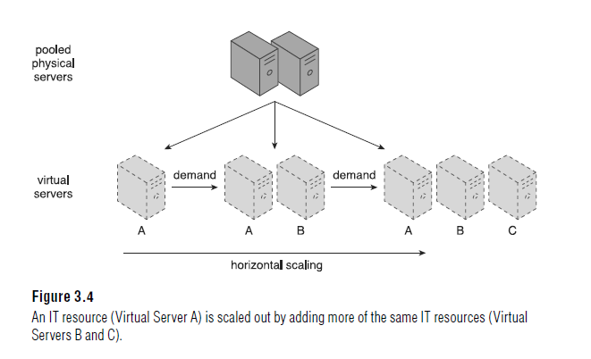
The allocating or releasing of IT resources that are of the same type is referred to as horizontal scaling (Figure ).
The horizontal allocation of resources is referred to as scaling out and the horizontal releasing of resources is referred to as scaling in.
Horizontal scaling is a common form of scaling within cloud environments.

Slide 28
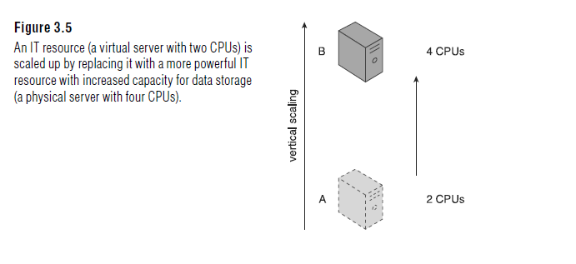
When an existing IT resource is replaced by another with higher or lower capacity, vertical scaling is considered to have occurred (Figure 3.5).
Specifically, the replacing of an IT resource with another that has a higher capacity is referred to as scaling up .
The replacing an IT resource with another that has a lower capacity is considered scaling down. Vertical scaling is less common in cloud environments due to the downtime required while the replacement is taking place.

Slide 29
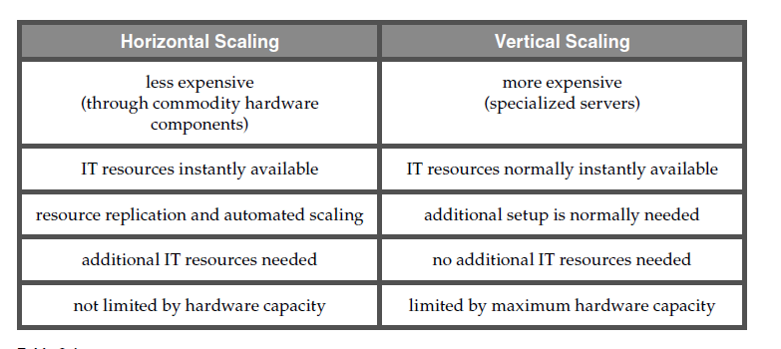

Slide 30
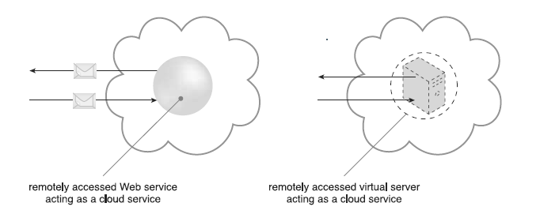
Cloud Services
A cloud service is any IT resource that is made remotely accessible via a cloud.
In Figure 3.6, the yellow circle symbol is used to represent the cloud service as a simple Web-based software program

Slide 31
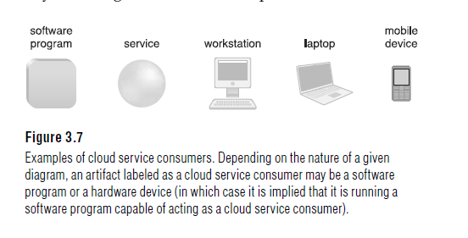
Cloud Service Consumer
The cloud service consumer is a temporary runtime role assumed by a software program when it accesses a cloud service.

Slide 32
Click here
Cloud Service Deployment Models

